Slide 1

Department of Computer Science and Engineering
Enhanced Multi-Zonal Forest Type Classification Using YOLOv8 and EuroSAT for Scalable Environmental Monitoring
PRESENTED BY
Nakka Vijay Bhaskar Reddy (22471A05H8)
Nagaram Prasad Rao (22471A05H7)
Mundlamuri Vijaya KumaraChari (22471A05H6)
Under the Guidance of,
Dr. Moturi Sireesha _{M.Tech, Ph.D}
Associate Professor,
Department of Computer Science and Engineering,
Narasaraopeta Engineering College (Autonomous),
Narasaraopet- 522 601.

Slide 2
CONTENTS
Abstract
Introduction
Literature Survey
Research Gaps
Problem Statement
Objectives
Block Diagram / Flow Diagram
Methodology
Implementation
Results and Analysis
Conclusion & Future Scope
References
Question and Answers
Acknowledgements

Slide 3
ABSTRACT
Forests are a critical component of the Earth’s ecosystem, yet monitoring them accurately over large areas remains a significant challenge. This research presents an intelligent deep learning (DL) approach using satellite imagery to achieve high-accuracy forest stand detection. The study aims to develop a faster, scalable, and automated forest analysis framework compared to traditional field-based surveys, utilizing the EuroSAT dataset for effective land cover classification. The YOLOv8-nano model was trained and evaluated to assess its capability in identifying forest and non-forest regions. A total of 27,000 satellite images across 10 distinct land-cover classes were used for validation, ensuring diverse and comprehensive data coverage. The model achieved a peak accuracy of 97.5%, demonstrating robust performance and real-time detection capability. These findings highlight the strong potential of the YOLOv8 architecture for environmental monitoring, forest conservation, and sustainable resource management. Overall, this study represents an important step toward integrating artificial intelligence and satellite imagery for efficient and scalable forest observation.

Slide 4
INTRODUCTION
Forests play a crucial role in carbon storage, biodiversity conservation, climate regulation, and providing economic value.
Forest image classification is essential for mapping vegetation types, monitoring ecosystem health, and supporting sustainable forest management.
Traditional methods like manual image interpretation and field-based surveys provide accurate results but are time-consuming, labor-intensive, and unsuitable for large-scale forest classification.
Earth Observation (EO) satellites such as Sentinel-2 and Landsat-8, combined with Artificial Intelligence (AI), enable automated and precise forest image classification.
The study utilizes YOLOv8, an advanced CNN-based model, trained on the EuroSAT dataset to perform multi-zonal forest classification with high accuracy.
A comparative analysis between YOLOv8n and EfficientNet-B4 evaluates performance using accuracy, precision, recall, and F1-score metrics on 27,000 satellite images.

Slide 5
LITERATURE SURVEY
No | Title | Author | Journal Name & Year | Methodology Adapted | Key Findings | Gaps
1 | A Deep Learning Approach to Estimate Canopy Height and Uncertainty | Subham Raj, Anurag Sharma, and Sriparna Saha | arXiv(2024) | ResUNet (CNN architecture with skip connections and regression output) | Explained variance improved by 10% using multi-seasonal data | Overestimation in sparse/short canopy regions Uncertainty in SAR-affected areas
2 | Dual-Task Learning for Dead Tree Detection and Segmentation | Anis Ur Rahman Einari Heinaro Mete Ahishali | International Journal of Applied Earth Observation and Geoinformation(2025) | Hybrid Self-Attention U-Net ,Watershed postprocessing framework | Effective in densely vegetated and overlapping canopy zones | Limited by availability of NIR bands and generalizability
3 | Data Augmentation in Earth Observation: A Diffusion Model Approach | Tiago Sousa Benoit Ries Nicolas Guelfi | MDPI AG (2025) | EO Diffusion Model with captioning & SatMAE backbones | Outperformed traditional and GAN-based augmentations | High computation- al cost Needs more forest-type augmentations
4 | Landsat-Bench: Datasets and Benchmarks for Landsat Foundation Models | Isaac Corley, Lakshay Sharma, Ruth Crasto | ICML(2025) | Geospatial Foundation Models SSL4EO-L Pretrained Networks | GFMs outperformed ImageNet-pretrained models by 4–5% in accuracy Enabled Landsat-based evaluation standard for EO tasks | Lacks real-time performance Dataset coverage still limited in some regions
5 | Satellite-Based Forest Stand Detection Using Artificial Intelligence | Patrik Kovacovic, Rastislav Pirnik, Julia Kafkova, | IEEE (2025) | YOLOv5, YOLOv8, Mask R-CNN | Effective in recognizing forests, roads, buildings from satellite imagery | Generalization to other geographies needs testing

Slide 6
LITERATURE SURVEY
Previous studies used deep learning models such as YOLOv5, Mask R-CNN, and EfficientNet for forest detection and classification.
These models achieved good accuracy, but often required high computational power and long training times.
Some research focused on forest fire detection and deforestation alerts, highlighting the potential of AI in environmental monitoring.
Only a few studies have implemented advanced YOLOv8 models specifically for detailed forest type classification.
The present work introduces new model combinations and enhanced preprocessing techniques to achieve higher accuracy and faster performance.

Slide 7
RESEARCH GAPS
Previous studies focused on general land-use classification rather than forest-specific detection.
Real-time forest monitoring using deep learning models was not explored adequately.
YOLOv8 models were not previously applied or compared for satellite-based forest classification.
Earlier works did not evaluate the trade-off between accuracy, speed, and computational cost.
Preprocessing and data augmentation techniques were underutilized in prior research.
Only a few studies have implemented advanced YOLOv8 models specifically for detailed forest type classification.
The present work introduces new model combinations and enhanced preprocessing techniques to achieve higher accuracy and faster performance.

Slide 8
PROBLEM STATEMENT
Accurate forest stand monitoring across large areas remains difficult using traditional field surveys due to time and cost constraints.
Existing deep learning models provide good accuracy but suffer from high computational requirements and slow processing.
Most current approaches lack real-time detection and multi-class land-cover classification capabilities.
There is a need for a lightweight, high-accuracy model like YOLOv8, capable of scalable and automated forest detection using EuroSAT satellite imagery.

Slide 9
OBJECTIVES
Our Research work aims to:
Develop an automated forest stand detection system using YOLOv8 and EuroSAT satellite images.
Enhance accuracy and speed of land-cover classification through optimized model training.
Apply data preprocessing and augmentation to improve model stability and reduce overfitting.
Compare YOLOv8 variants (nano, small, medium) to identify the most efficient model.
Support real-time forest monitoring for improved environmental management and conservation.

Slide 10
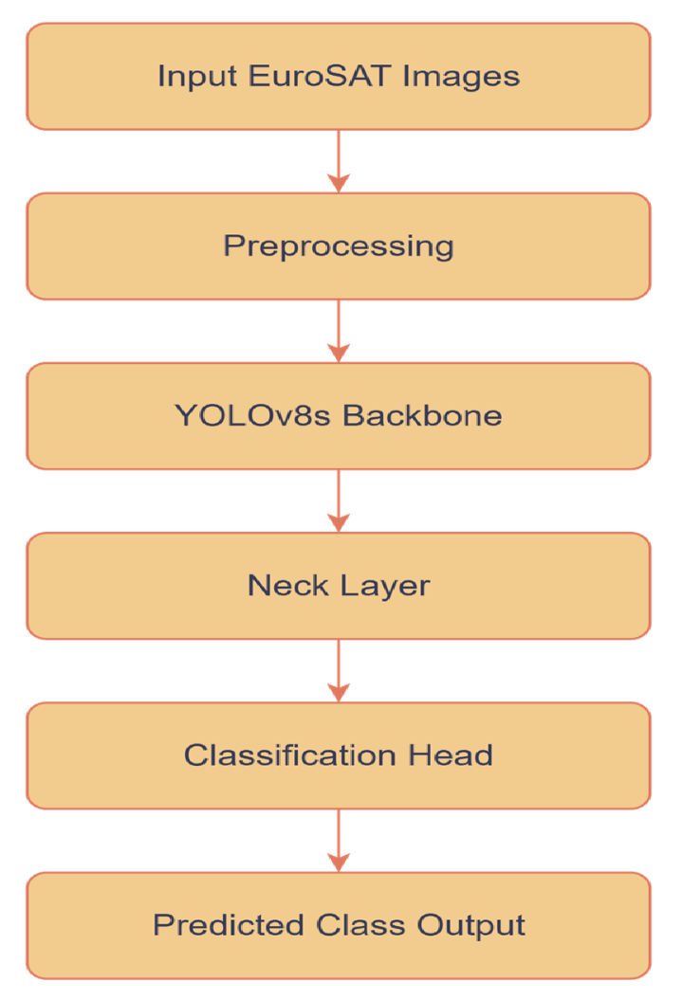
BLOCK DIAGRAM OR FLOW DIAGRAM

Slide 11
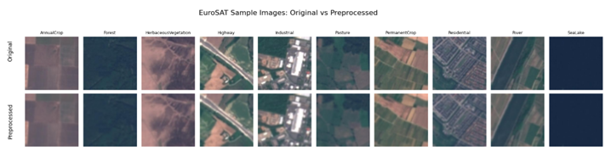
METHODLOGY
1. Dataset
Used EuroSAT satellite dataset (10 land-cover classes).
Each image: 64×64 px RGB, resized to 224×224 px.
Classes include Forest, Crop, Residential, Pasture, etc.
2. Data Preprocessing
Removed duplicates and checked for missing labels.
Normalized pixel values to [0,1].
Encoded labels numerically (one class per image).
Augmented data using flip, rotation, contrast, and
noise.
Split data: 80% training, 10% validation, 10% testing.

Slide 12
Data Set
3. Model Architecture (YOLOv8)
The proposed model is based on the YOLOv8 (You Only Look Once, version 8) architecture, developed by Ultralytics. It is a real-time object detection and classification framework optimized for speed and accuracy. Key phases include:
Backbone : Darknet-based convolutional layers for hierarchical feature extraction.
Neck: PAN-FPN (Path Aggregation Network with Feature Pyramid Network) for multi-scale feature fusion.
Head: Detection layers that predict class probabilities and bounding boxes in a single forward pass. Three model variants were tested YOLOv8n (nano), YOLOv8s (small), and YOLOv8m (medium) to evaluate trade-offs between speed and accuracy.

Slide 13
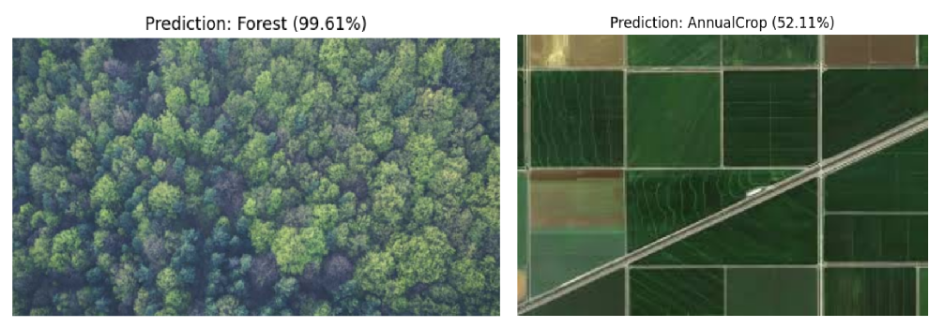
Data Set
4.Outcome
The model correctly identified the forest image with very high confidence (99.61%).
The second image contains Annual Crop fields along with a road, and the model predicted Annual Crop with 52.11% probability.
The predictions show the model can classify different land types from satellite images.
Forest regions are identified more accurately due to clear vegetation patterns.
Overall, the model provides reliable land-cover classification for monitoring and analysis.

Slide 14
IMPLEMENTATION
Implementation
Implemented using Ultralytics YOLOv8 framework in Python.
EuroSAT dataset preprocessed with resizing, normalization, and labeling.
Applied data augmentation (flip, rotate, brightness) to improve diversity.
Trained YOLOv8-nano, small, and medium models for forest stand detection.
Evaluated using Accuracy, Precision, Recall, and F1-Score.
Achieved 97.5% accuracy for real-time forest classification.
Software & Hardware
Software: Python, Ultralytics, OpenCV, PyTorch (Google Colab)
Hardware: Intel i5, 8GB RAM, NVIDIA GPU (T4/RTX)

Slide 15
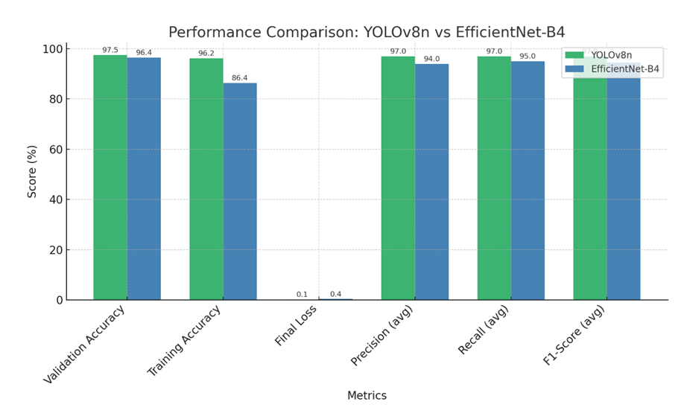
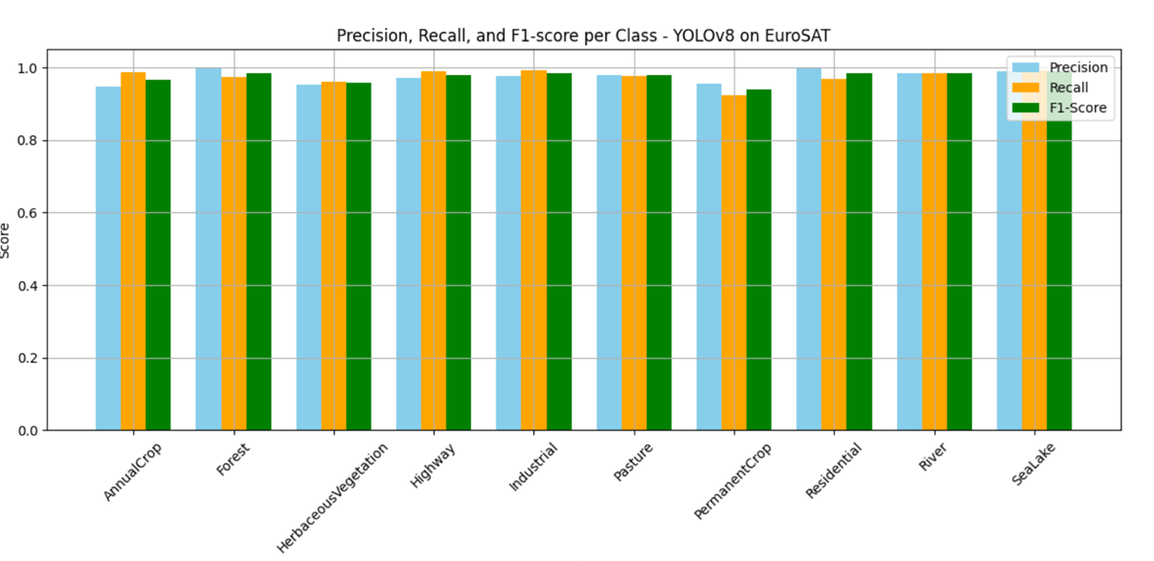
RESULTS & ANALYSIS
Results
Overall Accuracy: Achieved 97.5% on the EuroSAT dataset.
Precision: 97.8% | Recall: 98.2% | F1-Score: 97.8% - consistent across all classes.
Performance Comparison: YOLOv8 outperformed EfficientNet-B4 in both accuracy and processing speed.
Optimization Impact: Data augmentation and parameter tuning improved stability and minimized overfitting.
Model Capability: Effectively classified multiple land-cover types including forest regions.
Application Potential: Proven suitable for real-time, scalable forest monitoring and environmental analysis.

Slide 16
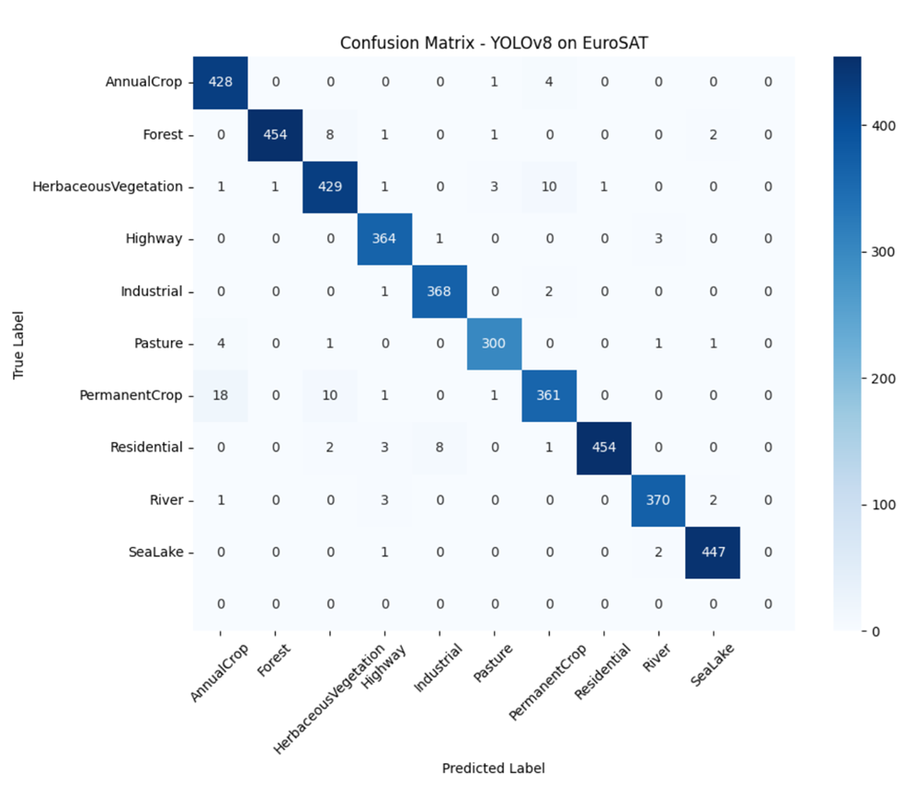
Data Set
Confusion Matrix :
Shows how many images were correctly and incorrectly classified.
Most values are on the diagonal line, which means the model classified most images correctly.
YOLOv8 performed very well on almost all classes.
The confusion matrix proves the model
is highly accurate, with very few
misclassifications.

Slide 17
Model Performance Evaluation:
Both YOLOv8 and EfficientNet-B4 models were evaluated using the EuroSAT dataset. YOLOv8 outperformed EfficientNet-B4 in all key metrics:
Accuracy: 97.5%
Precision: 97.8%
Recall: 98.2%
F1-score: 97.8%
EfficientNet-B4 achieved slightly lower results with an F1-score of 0.82.
Model | Accuracy (%) | Precision | Recall | F1-Score
YOLOv8n | 97.5 | 0.97 | 0.97 | 0.95
EfficientNet-B4 | 96.4 | 0.94 | 0.95 | 0.90

Slide 18
CONCLUSION and FUTURE SCOPE
Multi-zonal forest classification system using YOLOv8 and EuroSAT dataset
High accuracy and fast processing for real-time forest monitoring
YOLOv8 performed better than EfficientNet-B4 with less computation
Supports large-scale environmental analysis and sustainable forest management
Future work: expand dataset and optimize model for regional generalization and real-time use
Improved detection of diverse forest zones across different geographical areas
Reduced training time and lower resource consumption compared to other models
Contributes to climate studies and deforestation tracking using satellite imagery

Slide 19
REFERENCES
[1] P. Kovacovic, R. Pirnik, J. Kafkova, M. Michalik, A. Kanalikova, and P. Kuchar, ”Satellite-Based Forest Stand Detection Using Artificial Intelligence,” IEEE Access, vol. 13, pp. 10898–10915, Jan. 2025, doi: 10.1109/AC CESS.2025.3528215.
[2] I. Corley, L. Sharma, and R. Crasto, ”Landsat-Bench: Datasets and Benchmarks for Landsat Foundation Mod els,” in Proc. 42nd Int. Conf. on Machine Learning, Van couver, Canada, PMLR 267, 2025. [Online]. Available: https://arxiv.org/abs/2506.08780
[3] S. N. Amani, A. Yazdanpanah, and F. D. Yeganeh, ”Deep Transfer Learning-Based Forest Fire Susceptibility Map ping Using Satellite Imagery,” IEEE J. Sel. Topics Appl. Earth Observ. Remote Sens., vol. 16, pp. 6855–6869, 2023, doi: 10.1109/JSTARS.2023.3262657.
[4] C. H. Lu, Y. Zhang, Y. P. Wen, and D. Q. Lin, ”UAV and Deep Learning-Based Forest Fire De tection and Early Warning System,” IEEE Access, vol. 10, pp. 33089–33097, 2022, doi: 10.1109/AC CESS.2022.3161375.
[5] A. J. Gonzalez, A. E. Macedo, C. J. Ribeiro, and L. C. S. Magalh˜ aes, ”A Data-Driven Pipeline for Deforestation Alert System Based on Satellite Images,” IEEE Trans. Geosci. Remote Sens., vol. 61, pp. 1–13, 2023, doi: 10.1109/TGRS.2022.3197080.
[6] A. J. da Silva Junior, M. da Costa Silva, and A. L. M. Leal, ”Tree Species Recognition in the Amazon Rain forest Using Deep Learning and Hyperspectral Images,” in Proc. 2023 IEEE Int. Geosci. Remote Sens. Symp. (IGARSS), Pasadena, CA, USA, pp. 1640–1643, 2023, doi: 10.1109/IGARSS52108.2023.10281788.
[7] F. Petitjean, P. Ganc¸arski, F. Gillet, and T. Ganc¸arski, ”Satellite Image Time Series Analysis Under Time Warping,” IEEE Trans. Geosci. Remote Sens., vol. 53, no. 6, pp. 3181–3192, Jun. 2015, doi: 10.1109/TGRS.2014.2361383.
[8] D. S. K. Pillai, R. Mahajan, and A. Yadav, ”Deep Learning Based Forest Fire Detection Using Satellite Imagery and Weather Data,” in Proc. 2024 Int. Conf. on Environmental Intelligence (ICEI), Hyderabad, India, pp. 44–50, 2024.
[9] L. Valero, P. Ghamisi, and J. Chanussot, ”Improved Land Use Mapping Using Sentinel-2 Imagery and Semi-Supervised Learning,” IEEE Geosci. Remote Sens. Lett., vol. 15, no. 12, pp. 1939–1943, Dec. 2018, doi: 10.1109/LGRS.2018.2852854.

Slide 20
REFERENCES
[10] B. Saricayir and C. Ozcan, ”EfficientNet Deep Learning Model for Satellite Image Classification Using the Eu roSAT Dataset,” in Proc. 8th Int. Workshop on Computer Modeling and Intelligent Systems (CMIS-2025), Zapor izhzhia, Ukraine, May 2025. CEUR Workshop Proceed ings. [Online]. Available: https://ceur-ws.org
[11] C. S. Preetham, C. Mahesh, C. S. Haripriya, R. Anirudh, and M. S. Sireesha, “Spectrum Sensing in Cognitive Radio by Use of Volume-Based Method,” *International Journal of Engineering and Technology (UAE)*, vol. 7, no. 2.17, pp. 732–735, 2018, doi: 10.14419/ijet.v7i2.17.11554.
[12] K. Lakshminadh, D. C. V. Guptha, J. Sai, K. Rajesh, S. Moturi, Y. Neelima, and D. V. Reddy, “Advanced Pest Identification: An Efficient Deep Learning Approach Using VGG Networks,” in *Proc. IEEE Int. Conf. on Interdisciplinary Approaches in Technology and Man agement for Social Innovation (IATMSI)*, 2025, pp. 215–220, doi: 10.1109/IATMSI64286.2025.10984619.
[13] S. S. N. Rao, C. Sunitha, S. Najma, N. Nagalakshmi, T. G. R. Babu, and S. Moturi, “Advanced Water Quality Prediction: Leveraging Genetic Optimization and Ma chine Learning,” in *Proc. IEEE Int. Conf. on Interdisci plinary Approaches in Technology and Management for Social Innovation (IATMSI)*, 2025, pp. 301–306, doi: 10.1109/IATMSI64286.2025.10984615.
[14] K. V. N. Reddy, Y. Narendra, M. A. N. Reddy, A. Ramu, D. V. Reddy, and S. Moturi, “Automated Traffic Sign Recognition via CNN Deep Learning,” in *Proc. IEEE Int. Conf. on Interdisciplinary Ap proaches in Technology and Management for So cial Innovation (IATMSI)*, 2025, pp. 330–335, doi: 10.1109/IATMSI64286.2025.10985223.
[15] S. N. T. Rao, T. C. Dulla, V. K. Kolla, G. S. Kurakula, M. Suneetha, S. Moturi, and D. V. Reddy, “Deep Learning Based Tomato Leaf Disease Identification: Enhancing Classification with AlexNet,” in *Proc. IEEE Int. Conf. on Interdisciplinary Approaches in Technology and Man agement for Social Innovation (IATMSI)*, 2025, pp. 360–365, doi: 10.1109/IATMSI64286.2025.10984969

Slide 21



